Slide 1

CSC351-Operating Systems
Week-1 Lecture-1,2
Semester #05
                Prepared by:
                M. Shoaib

Slide 2
Instructor Contact Details
Name: Miss M. Shoaib
Course Instructor: CSC351- Operating Systems
Credit Hours: 2+1
Designation: Lecturer
Email: nailanoreen@lgu.edu.pk
Staffroom: first floor NB, female staffroom

Slide 3
Course Learning Outcomes
Upon completion of the course, students will be able to:
Describe fundamental operating system abstractions(concept) such as processes, threads, files, semaphores, IPC abstractions, shared memory regions, etc.
Investigate important algorithms e.g., Process scheduling and synchronization
Classify the operating system’s resource management techniques, dead lock management techniques, memory management algorithms, file management.

Slide 4
Recommended Resources
Textbook
  Operating Systems Concepts, 9th edition by Abraham Silberschatz
Other
  Modern Operating Systems, 4th edition by Andrew S. Tanenbaum
  Operating Systems, Internals and Design Principles, 9th edition by William Stallings
  Davis, W.S. and Rajkumar, T.M. (2004) Operating Systems: A Systematic View. 3rd Ed.Harlow, Addison-Wesley.

Slide 5
Agenda for Today
Introduction and purpose of the course
Organization of a computer system
Purpose of a computer system—setting the stage for OS concepts and principles
Outline of topics to be discussed in the course
What is an operating system?
History and Evolution

Slide 6
Agenda for Today
Single-user systems
Batch systems
Multiprogram systems
Time-sharing systems
Distributed systems
Real-time systems
Mobile OS
Interrupts, traps, and signals
CPU, I/O, and memory protection Interactive

Slide 7
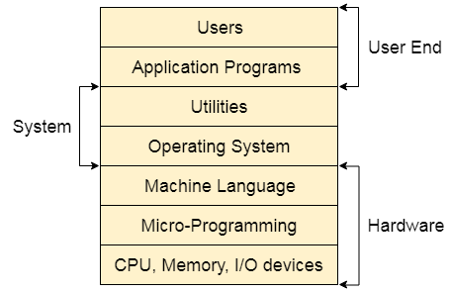
Structure of a Computer System
A Computer System consists of:
Users (people who are using the computer)
Application Programs (Compilers, Databases, Games, Video player, Browsers, etc.)
System Programs (Shells, Editors, Compilers, etc.)
Operating System ( A special program which acts as an interface between user and hardware )
Hardware ( CPU, Disks, Memory, etc.)

Slide 8
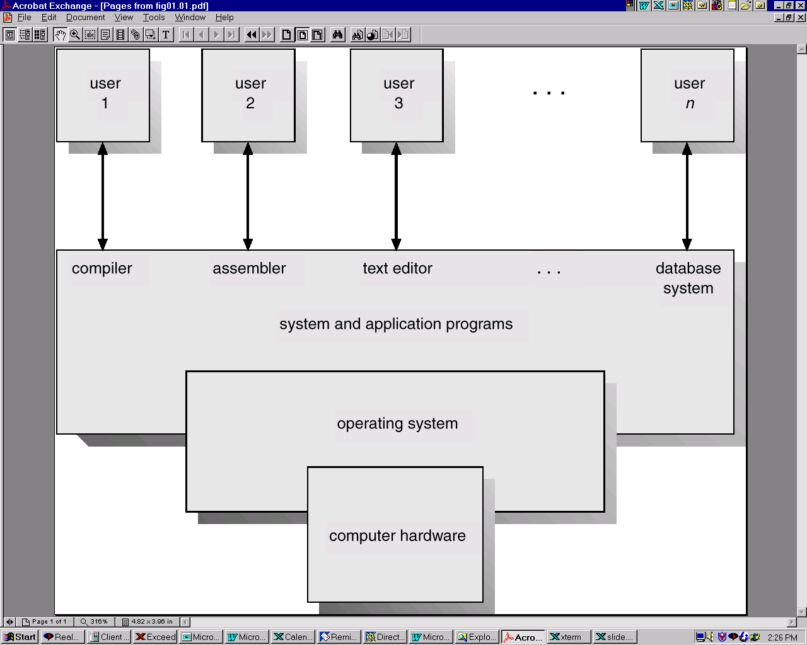
Layered View of a Computer System
Notes:
Assembler converts low level machine language to high level human language

Slide 9

Purpose of a Computer System
Computer systems consist of software and hardware that are combined to provide a tool to solve specific problems in an efficient manner
Execute programs

Slide 10
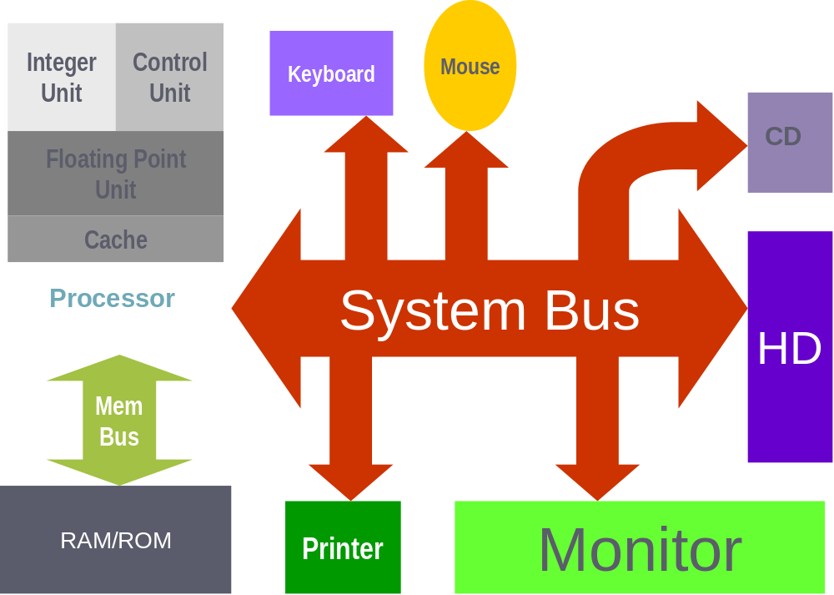
Computer System Hardware

Slide 11
Computer System Hardware
Processor (CPU)
Integer Unit: Handles arithmetic and logical operations with integers (like addition, subtraction, AND, OR).
Control Unit (CU): Directs the flow of instructions and data; tells other parts of the system what to do.
Floating Point Unit (FPU): Performs arithmetic on real numbers (decimals, fractions), useful for scientific calculations.
Cache: A small, very fast memory inside the CPU that stores frequently used instructions/data for quick access
System Bus
Acts like a highway connecting all the main components.
Transports data, addresses, and control signals between the CPU, memory, and input/output (I/O) devices.

Slide 12
Computer System Hardware
Memory Bus
Connects the CPU to RAM/ROM.
RAM (Random Access Memory): Temporary, volatile storage for currently running programs and data.
ROM (Read Only Memory): Permanent memory storing essential instructions (like firmware/bootloader).
Input Devices (connected via System Bus)
Keyboard: Used to input text and commands.
Mouse: Used to control the graphical interface (cursor movement, clicks).

Slide 13
Computer System Hardware
Output Devices
Monitor: Displays information visually to the user.
Printer: Produces a physical (paper) copy of digital information.
Storage Devices
HD (Hard Disk): Long-term data storage, holds the operating system, applications, and files.
CD: Optical disk used for reading/writing data (older storage medium, still shown here for completeness).

Slide 14
What is an Operating System?
A program that acts as an intermediary between a user of a computer and the computer hardware—provides the user a simpler (virtual) machine to work with
A program that allocates and deallocates computer system resources in an efficient, fair, and secure manner—a resource manager system. It takes preventive measures whenever required to avoid errors.
Why do we need an OS
It manages the computer's memory and processes, as well as all of its software and hardware. It also allows you to communicate with the computer without knowing how to speak the computer's language. Without an operating system, a computer is useless.

Slide 15
Functions of Operating System
It boots the computer
It performs basic computer tasks e.g., managing the various peripheral devices e.g., mouse, keyboard
It provides a user interface, e.g., command line, graphical user interface (GUI)
It handles system resources such as computer's memory and sharing of the central processing unit(CPU) time by various applications or peripheral devices.
It provides file management which refers to the way that the operating system manipulates, stores, retrieves and saves data.
Error Handling is done by the operating system. It takes preventive measures whenever required to avoid errors.

Slide 16
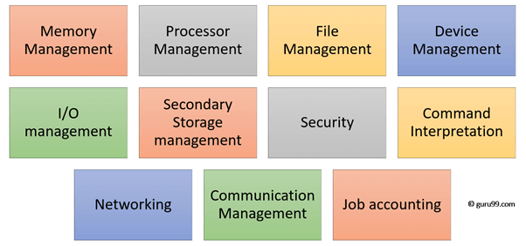
Functions of Operating System

Slide 17
Operating System Goals
Execute user programs and make solving user problems easier.
Make the computer system convenient to use.
Use the computer hardware in an efficient manner.

Slide 18
How OS Start and develop through ages
The first operating systems were developed in the 1950s, when computers could only run one program at a time. Later in the following decades, computers began to include more and more software programs, sometimes called libraries, that came together to create the start of today's operating systems.
In the late 1960s, the first version of the Unix operating system was developed. Written in programming language C
Many modern operating systems, including Apple OS X and all different versions of Linux, date back or rely on the Unix OS.
Microsoft Windows was developed in response to an IBM request for an operating system to run its range of personal computers or PCs.

Slide 19
How OS Start and develop through ages (Legacy OS to Modern OS)
The first operating system created by Microsoft was not called Windows, it was called MS-DOS and it was built in 1981 when it bought the 86-DOS operating system from Seattle Computer Products and modified it to meet IBM requirements.
The Windows name was first used in 1985 when a graphical user interface was created and paired or joined with the MS-DOS.
Today, Apple, OS X, Microsoft Windows and the various forms of Linux (including Android) dominate the vast majority of the modern operating systems market,

Slide 20
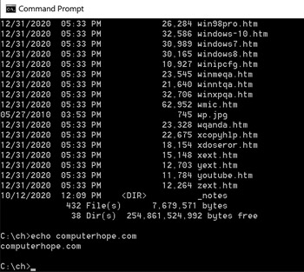
MS-DOS
Short for Microsoft Disk Operating System, MS-DOS is a non-graphical command line operating system derived from 86-DOS that was created for IBM compatible computers
MS-DOS allows the user to navigate, open, and otherwise manipulate files on their computer from a command line instead of a GUI like Windows.
Today, MS-DOS is no longer used; however, the command shell, more commonly known as the Windows command line is still used by many users.
In MS-DOS, you would navigate to the folder using the cd command and then list the files in that folder using the dir command.

Slide 21
Windows
The Windows operating system (Windows OS) for desktop PCs is more formally called Microsoft Windows and is actually a family of operating systems for personal computers.
Windows provides a graphical user interface (GUI), virtual memory management, multitasking, and support for many peripheral devices. In addition to Windows operating systems for personal computers, Microsoft also offers operating systems for servers and mobile devices.
Windows comes pre-loaded on most new PCs, which helps to make it the most popular operating system in the world.

Slide 22
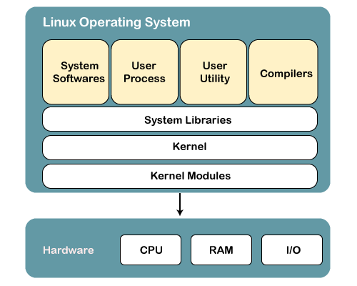
UNIX/LINUX
Unix is the most powerful and popular multi-user and multi-tasking Operating System.

Slide 23
OS2
The name stands for "Operating System/2", because it was introduced as part of the same generation change release as IBM's "Personal System/2 (PS/2)" line of second-generation personal computers. The first version of OS/2 was released in December 1987 and newer versions were released until December 2001.
OS/2 has many of the same commands as DOS, can read DOS disks, but it is more sophisticated than DOS.
In particular, OS/2 is a multi-tasking, multi-threaded operating system.
S/2 also includes a graphical user interface, or GUI, called Presentation Manager, and which makes OS/2 look and work something like the Macintosh or Windows.

Slide 24
MAC Operating System
The Macintosh Operating System (Mac OS) is an operating system (OS) designed by Apple Inc. to be installed and operated on the Apple Macintosh series of computers.
Introduced in 1984, it is a graphical user interface (GUI) based OS that has since been released as multiple different versions.
Mac OS is a completely capable OS that provides functionality and services like Windows or Linux OS. Some of the code base and features of Lisa OS have been incorporated in Mac OS.
As of 2012, Mac OS released several versions, including Macintosh 128k, Mac OS 7, Mac OS X and Mac Mountain Lion.

Slide 25
Android Operating System
Android is an open source and Linux-based Operating System
The Android operating system is a mobile operating system that was developed by Google (GOOGL​) to be primarily used for touchscreen devices, cell phones, and tablets.
Its design lets users manipulate the mobile devices intuitively, with finger movements that mirror common motions, such as pinching, swiping, and tapping.
Google also employs Android software in televisions, cars, and wristwatches—each of which is fitted with a unique user interface.
Android applications are usually developed in the Java language using the Android Software Development Kit.
Once developed, Android applications can be packaged easily and sold out either through a store such as Google Play, SlideME, Opera Mobile Store, Mobango, F-droid and the Amazon Appstore.

Slide 26
iOS
iOS is a mobile operating system developed by Apple. It was originally named the iPhone OS but was renamed to the iOS in June 2009.
The iOS currently runs on the iPhone, iPod touch, and iPad. Like modern desktop operating systems, iOS uses a graphical user interface, or GUI.
iOS, an acronym for iPhone Operating System, is a Unix-derived operating system powering all of Apple’s mobile devices
The first version of iOS introduced the culture to the touch-screen smartphone, a significant cultural shift away from flip phones and Blackberry-style devices.
The iPhone combined many functions within a single device, including a camera, internet browser, and media player alongside the phone and messaging, and the world would never be the same

Slide 27
Task
What are the differences between system software and application software?
What is an operating system (OS)? Provide examples of operating systems from daily life.
What does an operating system do?
What is a graphical user interface (GUI) in an operating system?
What is the difference between a mobile operating system and a desktop operating system?
Why is it important to have an operating system on a computer?
What were some of the early operating systems used in the past?
What are the different types of operating systems that are commonly used today?
What is Linux and Unix Operating system?
List five Linux-based applications and discuss their advantages and disadvantages?

Slide 28
Single user operating systems
Personal computers – computer system dedicated to a single user.(many but 1 at a time)
Interactive(Accepting input from a human. Interactive computer systems are programs that allow users to enter data or commands. Most popular programs, such as word processors and spreadsheet applications, are interactive.
A non interactive program is one that, when started, continues without requiring human contact. A compiler is a non interactive program)
User convenience and responsiveness.

Slide 29
Single & Multi user Operating systems
Feature | Single-User Operating System | Multi-User Operating System
Number of Users | Supports only one user at a time | Supports multiple users simultaneously
Resource Sharing | No sharing – all resources used by one person | Resources (CPU, memory, storage) are shared among users
Complexity | Simple and easy to use | More complex, requires advanced management
Examples | MS-DOS, Windows (personal editions), macOS, Android, iOS | UNIX, Linux (server editions), Windows Server, Mainframes
Cost | Generally cheaper | More expensive (requires stronger hardware & licensing)
Performance | Optimized for a single user’s tasks | Performance depends on resource allocation among users
Use Case | Personal computers, laptops, smartphones | Servers, mainframes, enterprise systems

Slide 30
Batch Operating systems
First Fundamental system.
User ≠ operator
Reduce setup time by batching similar jobs
Automatic job sequencing – automatically transfers control from one job to another.
Resident monitor :
  initial control in monitor
  control transfers to job
  when job completes
  control transfers back to monitor
  User → Batch Jobs → Batch OS → Execution (Output)
Notes:
Examples of Batch OS: payroll system, bank statements, data entry, etc.

Slide 31
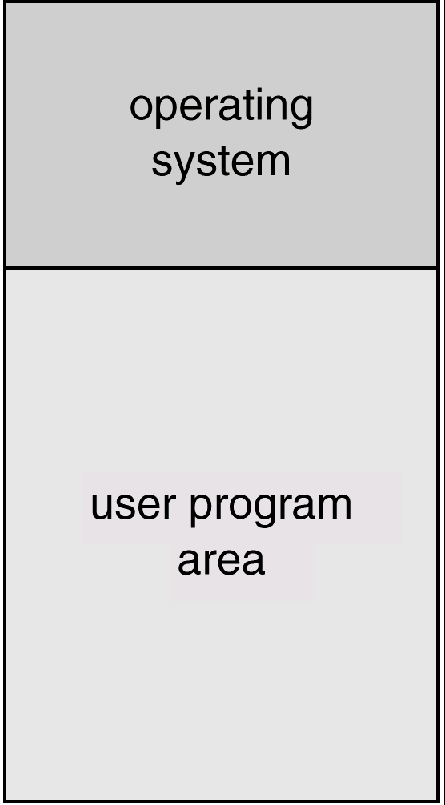
Memory layout of batch systems
OS in upper part → controls the system.
User program area → executes user applications

Slide 32
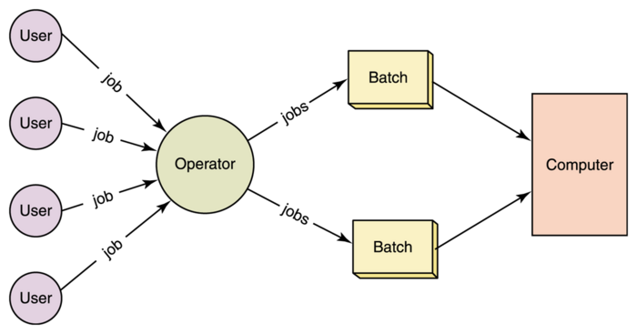
Batch system (conti…)

Slide 33
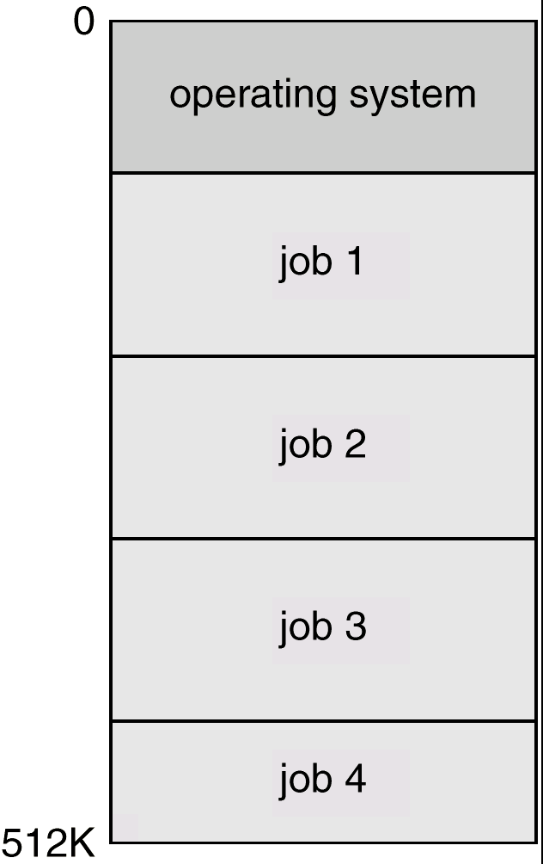
Multi-programmed systems (non preemptive)
Sharing the processor, when two or more programs reside in memory at the same time, is referred as multiprogramming
Multiprogramming increases CPU utilization by organizing jobs so that the CPU always has one to execute.
Several jobs are kept in main memory at the same time, and the CPU is multiplexed among them.
Multiprogramming operating systems monitor the state of all active programs and system resources using memory management programs to ensures that the CPU is never idle, unless there are no jobs to process.

Slide 34


Multiprogrammed Systems
Example: Two processes P1 and P2 with CPU and I/O bursts of one time unit each

Slide 35
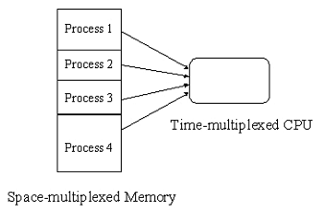
Os features needed for Multiprogramming
Spooling (Simultaneous Peripheral Operation On-Line)(put job in buffer)
Memory management
CPU scheduling

Slide 36

Time sharing systems
A multi user and multi process system.
An interactive system with multiprogramming
To obtain a reasonable response time, jobs may have to be swapped in and out of main memory.
UNIX, Linux, Widows NT server, and Windows 2000 server

Slide 37
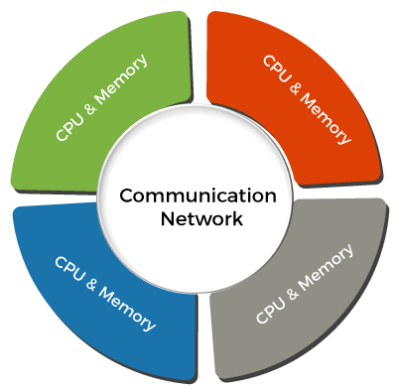
Distributed Operating System
Distributed systems use many central processors to serve multiple real-time applications and users. As a result, data processing jobs are distributed between the processors.
It connects multiple computers via a single communication channel. Furthermore, each of these systems has its own processor and memory.
Additionally, these CPUs communicate via high-speed buses or telephone lines. Individual systems that communicate via a single channel are regarded as a single entity. They're also known as loosely coupled systems.

Slide 38
Real Time systems
A data processing system in which the time interval required to process and respond to inputs is so small that it controls the environment
the time taken by the system to respond to an input and display of required updated information is termed as the response time
A real-time operating system must have well-defined, fixed time constraints, otherwise the system will fail such as controlling scientific experiments, medical imaging systems, industrial control systems, and some display systems. Plane landing. Ventilators.
Real-Time systems may be either hard or soft real-time.

Slide 39
Real Time systems
Hard real-time systems:
  Secondary storage limited are absent, data stored in short term memory, or read-only memory (ROM).coz time is short
  No virtual memory—time cannot be “wasted” on translation of logical to physical addresses.
  OS code structured for efficiency
  Plane landing systems, process control in nuclear power plants, ventilators, etc.

Slide 40
Real time systems (Cont..)
Soft real-time systems
  Output should be produced within the given time constraints but if it is not, Missing the deadline may cause inconvenience, delay, or reduced performance, but it won’t cause a disaster, injury, or system failure.
  Useful in applications (Live Video Streaming) requiring advanced operating-system features
Mobile Communication
Music Playing Robots
Weather Station

Slide 41
Mobile OS
OS for smartphones, tablets, and PDA’s. It is a platform on which other applications can run on mobile devices.
Examples of the Mobile OS: Android OS, ios, Symbian OS, and windows mobile OS

Slide 42
Interrupts
Interrupts are signals sent to the CPU by external devices, normally I/O devices. They tell the CPU to stop its current activities and execute the appropriate part of the operating system
After the interrupt signal is sensed, the computer either resumes running the current program or begins running another program.
An operating system usually has some code that is called an interrupt handler. The interrupt handler prioritizes the interrupts and saves them in a queue if more than one is waiting to be handled.

Slide 43
Interrupts, Traps and Signals
Interrupt---an event generated by a device in a computer to get attention of the CPU(from hardware devices)
Trap—an event by the CPU itself as it executes a program
Signal—an event generated by a user

Slide 44


Interrupts, trap, signals
If you press any key(keyboard) or moving the mouse…..Example of interrupt
Hardware may trigger an interrupt at any time by sending a signal to the CPU usually by way of the system bus.
Software may trigger an interrupt by executing a special operation called a system call
Answer the Phone
.
.
.
Resume

Slide 45
Interrupts, trap, signals
A process can generate a trap, for example, by dividing a number by zero.
caused either by an error (division by zero or invalid memory access) or by a user request for an operating system service.
A user or a process may generate a signal (an interrupt to a process)

Slide 46
Interrupt handling
In case of interrupt or trap, the CPU invokes a piece of code in the OS to service it, known as interrupt service routine(ISR) or trap service routine(TSR)
In case of signal, the process can take one of the three possible actions , default action as defined by OS, ignore signal, or take a programmer specified action

Slide 47
Interrupt handling (Cont..)
Interrupt transfers control to the interrupt service routine, generally, through the interrupt vector, which contains addresses of all the interrupt service routines.
Interrupt architecture must save the address of the instruction after the interrupted instruction and the CPU state so that execution of the interrupted process may continue after the interrupt has been serviced.

Slide 48
As we have time sharing system so multiple user may be there. Here comes the issue of protection
One user may delete the files of others.
Or may overwrite program in memory

Slide 49
Hardware protection
Dual-Mode Operation
I/O Protection
Memory Protection
CPU Protection

Slide 50
Dual Mode Operation
Sharing system resources requires operating system to ensure that an incorrect program cannot cause other programs to execute incorrectly.
Provide hardware support to differentiate between at least two modes of operations.
  User mode – execution done on behalf of a user.
  Monitor mode (also kernel mode or system mode) – execution done on behalf of operating system.

Slide 51
Dual Mode Operation
Mode bit added to computer hardware to indicate the current mode: monitor (0) or user (1).
When an interrupt or fault occurs hardware switches to monitor mode.
Privileged instructions can be issued only in monitor mode.
Interrupt/fault
monitor
user
set user mode

Slide 52
Task
You are developing a real-time monitoring system for a hospital that tracks patients’ vital signs, such as heart rate, blood pressure, and oxygen levels. The system must alert medical staff immediately if a patient's condition become worst.
Questions:
Real-Time Requirements:
Identify which tasks in the monitoring system would be classified as hard real-time and which
would be soft real-time. Justify your classifications.
Interrupts, Traps and Signals
Interrupts vs Traps
Dual Mode Operation

Slide 53
Task
An employee is running a word processor, listening to music, and downloading a file at the same time on a single computer.
The OS of that computer loads multiple programs into memory so they can share CPU time efficiently.
The company also connects several computers together over a network so that tasks like file storage and computation can be shared

Slide 54
Summary
Today we learnt about
  Operating System Basics
  Course Outline

